Slide 1
Creative Coding Club
Free IoT Practical Coding Workshop 4

Slide 2
Meetup Hosts
Dipto Pratyaksa
Raymond Chan
Looking for volunteer co-hosts and speakers

Slide 3
How are we different?
No specific technology / platform
Very practical, focus on software development
A coding dojo
Mini hackhathons
Cross expertise

Slide 4
Free Workshop series
11/2/2018 Club established
25/2/2018 IoT workshop 1 Arduino & breadboards
11/3/2018 IoT workshop 2 Arduino & breadboards
25/3/2018 IoT workshop 3 ESP8266 & wifi
Today
8/4/2018 IoT workshop 4 ESP8266 & wifi
Next meetups
22/4/2018 IoT workshop 5 Controlling IoT via phones
6/5/2018 IoT workshop 6 Python and data

Slide 5
Courses in May 2018
Arduino and electronics prototyping class
1 day class $99 / person
4 hours of lesson, hands on exercise, and group discussion
Arduino kit, breadboards, and basic electronic components kit
Sample codes
Class notes
IoT fundamental class
1 day class $99 / person
4 hours of lesson, hands on exercise, and group discussion
ESP8266 kit and breadboards, and basic electronic components kit
Sample codes
Class notes

Slide 6
Workshop #4 Today’s Agenda
1.00 Creative Coding Club Raymond
1.15 Past workshops recap Raymond
1.45 NodeMCU ESP8266 Dipto
2.00 Build and Code All
3.00 Meetup concludes All

Slide 7
House Keeping OH&S
Emergency exit, toilets
Safety:
Always disconnect power before you modify electronic components
Never short-circuit: Red wire + black wire = FIRE!
Reverse polarity = FRIED BOARD
Check and double check your wiring
In case of incident, switch off power supply, ask for help

Slide 8
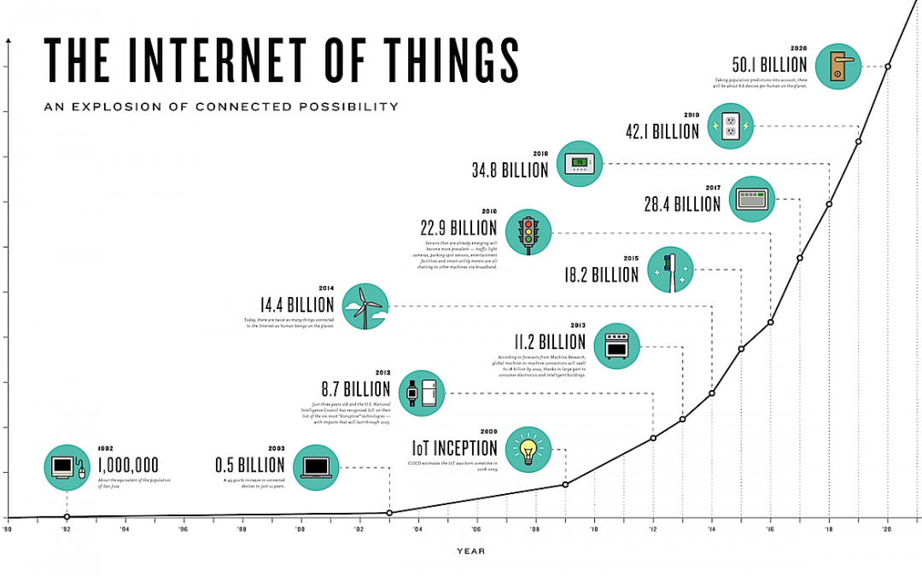

Slide 9
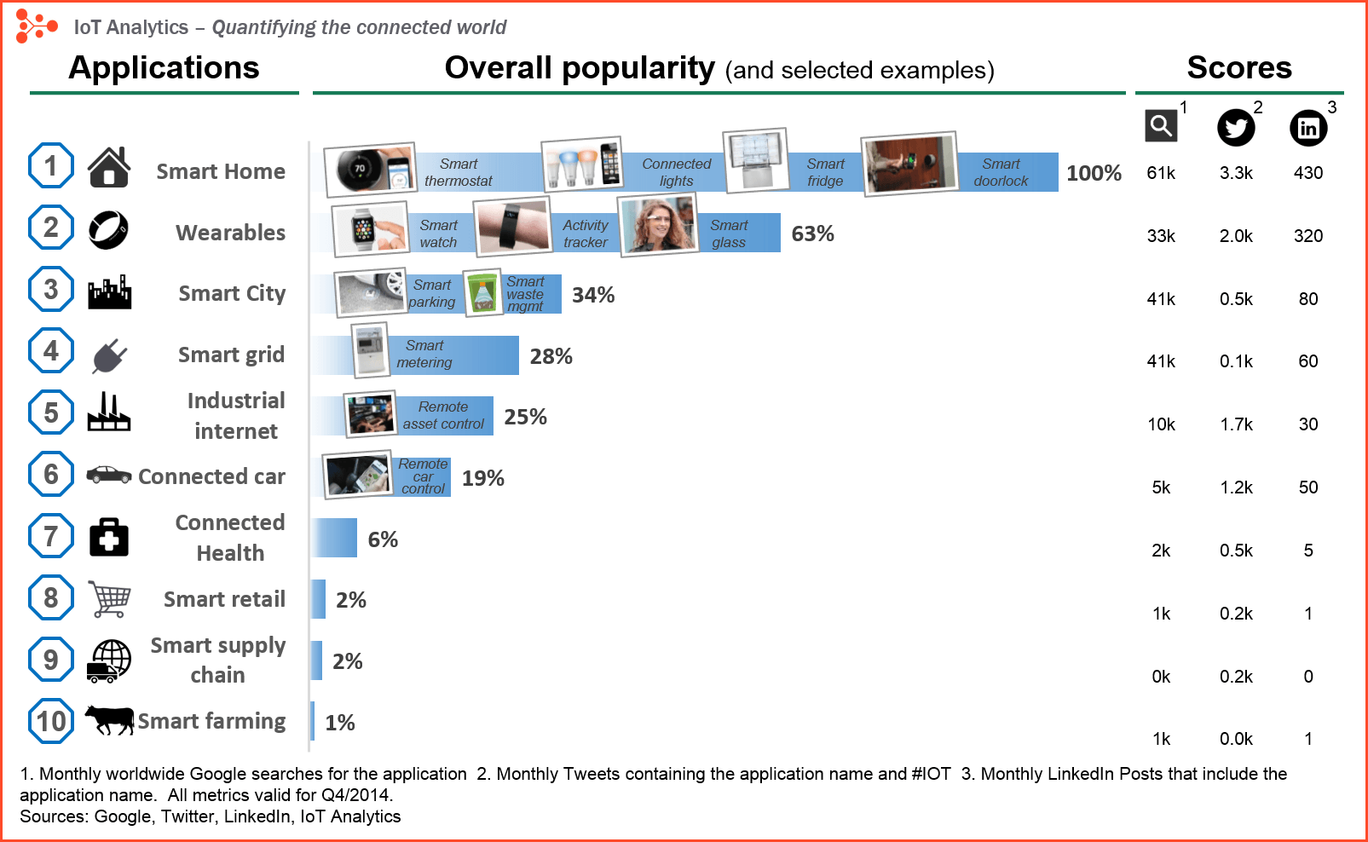

Slide 10

Source: Deloitte website

Slide 11
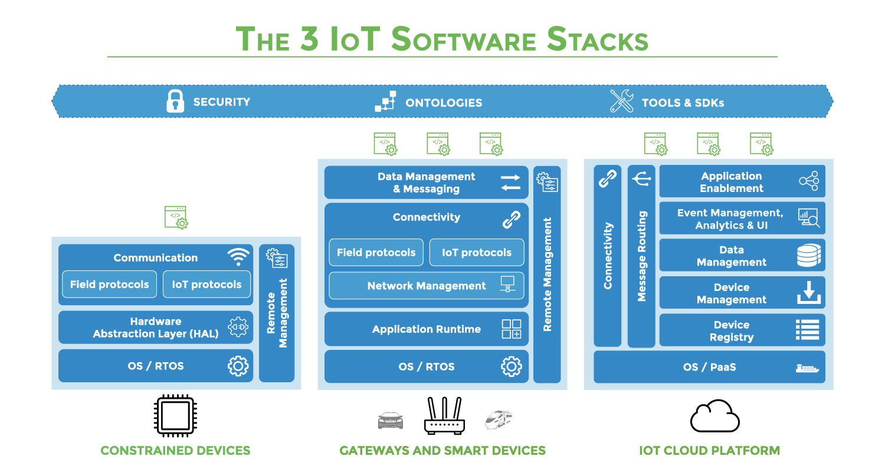

Slide 12
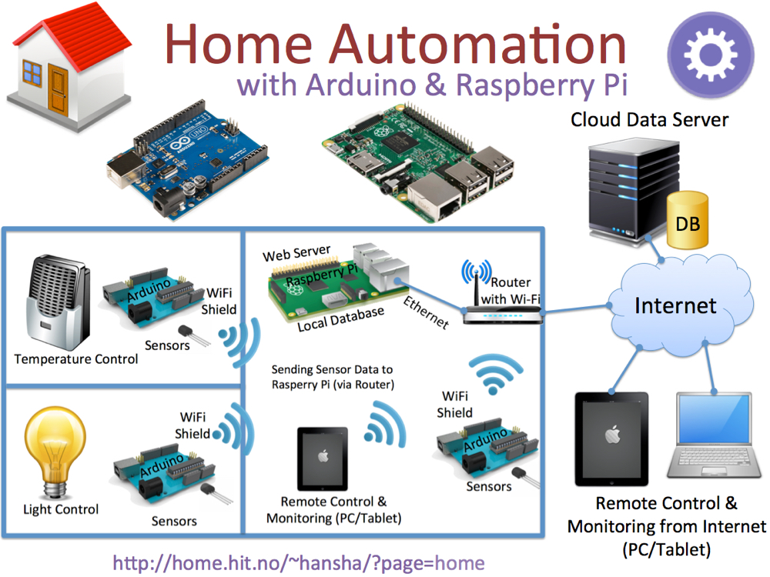

Slide 13
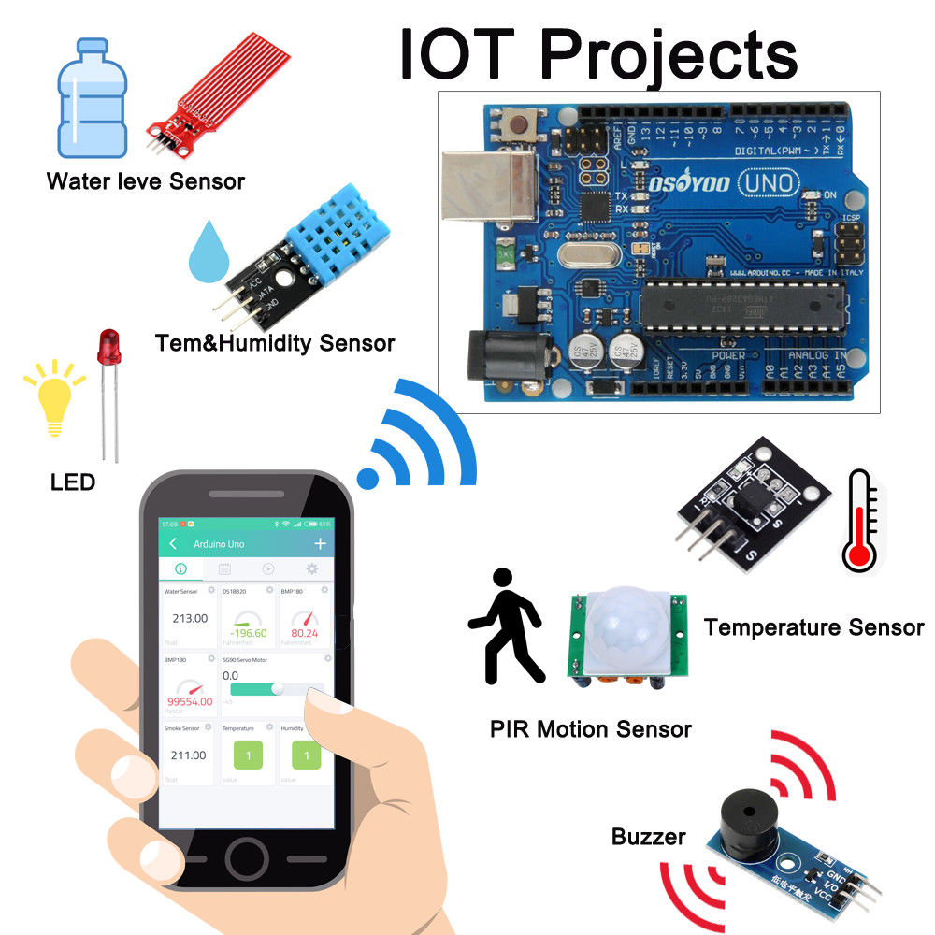

Slide 14
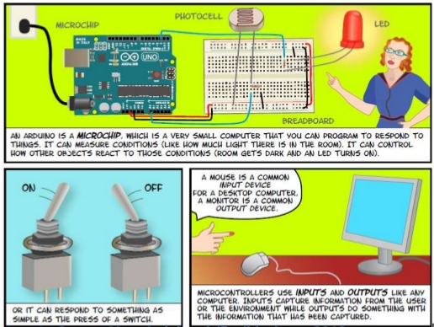

Slide 15
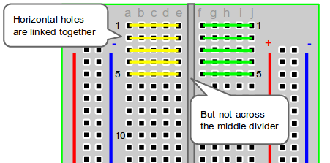
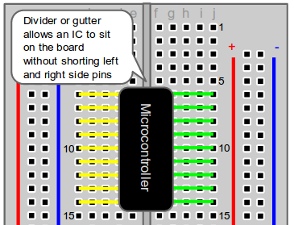
The Breadboard - Horizontal Columns

Slide 16
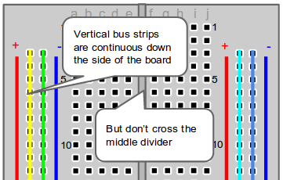
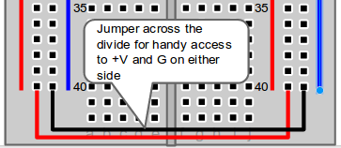
The Breadboard - Vertical Columns

Slide 17
Code Overview
Arduino Sketch
A sketch is the name that Arduino uses for a program. It's the unit of code that is uploaded to and run on an Arduino board.
C/C++ codes with pre-built libraries
https://www.arduino.cc/en/Tutorial/Sketch
Arduino Genuino IDE
Code
Verify
Upload
https://www.arduino.cc/en/Guide/Environment

Slide 18
Typical code structure
setup()
loop()

Slide 19
Arduino Serial Communications
How to 'talk' to this thing?
http://www.ladyada.net/learn/arduino/lesson4.html

Slide 20
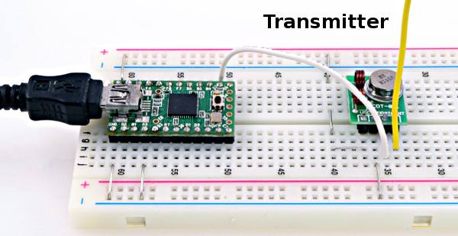
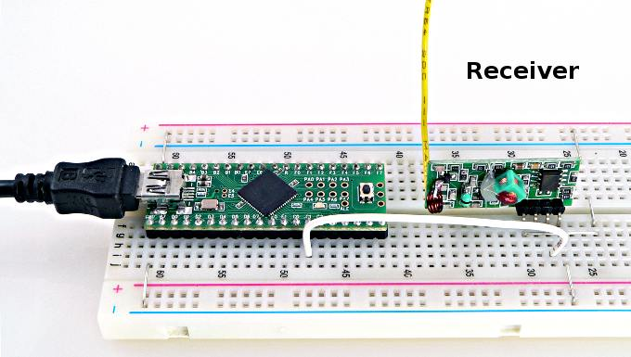
Sending data wireless: RF
RF transmitter and receiver 433Hz

Slide 21
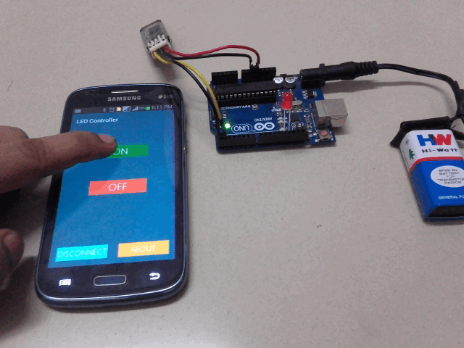
Sending data wireless: Bluetooth

Slide 22
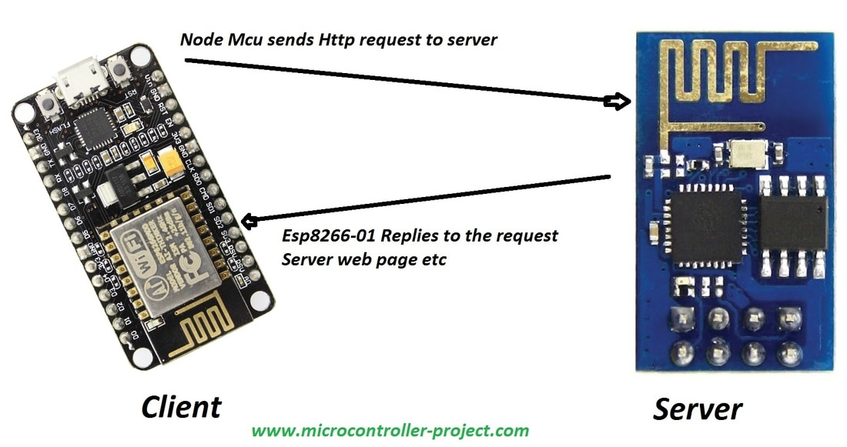
Sending data wireless: Wifi

Slide 23
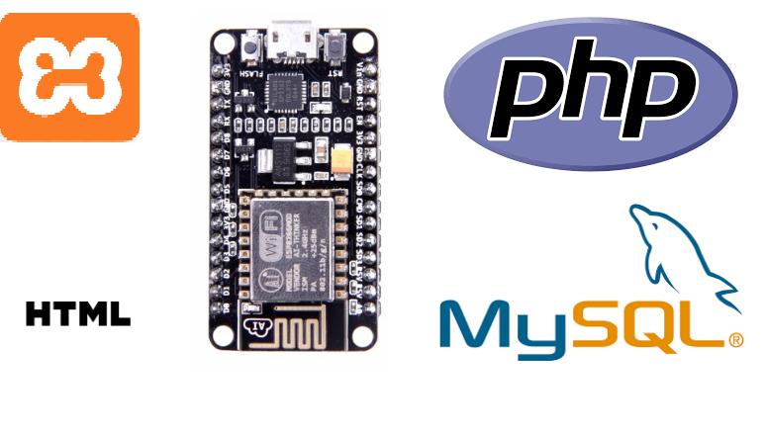
Open-source and open hardware IoT solutions

Slide 24
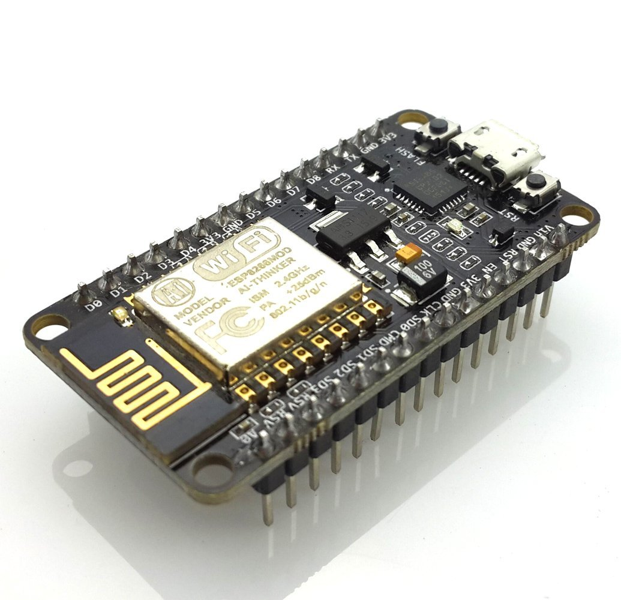
NodeMCU ESP8266 Class

Slide 25
What is the ESP8266?
Microprocessor and WIFI board
Full TCP/IP stack
32-bit RISC microprocessor
16 GPIOs
Less than $4
Perfect for IOT projects

Slide 26
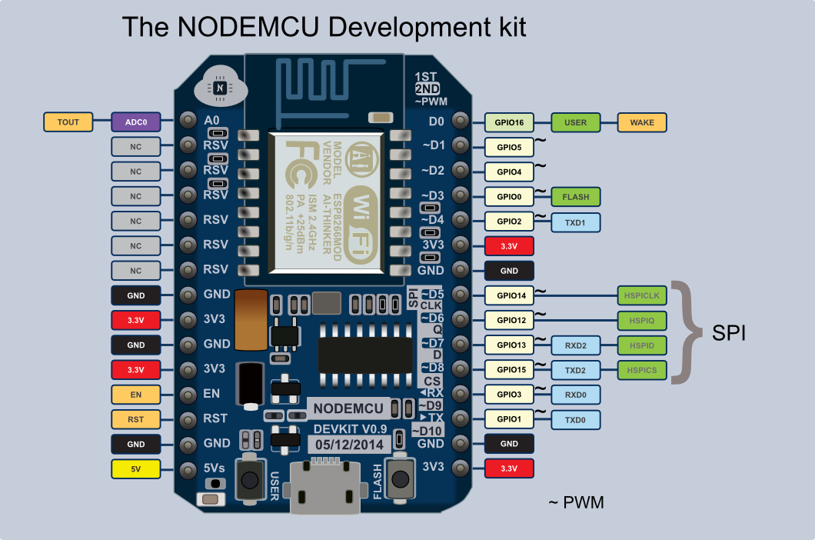

Slide 27
What is the NodeMCU?
Development board for the ESP8266
USB Programmable
Easier to use
More expensive, wouldn’t be used for mass production, just for prototyping

Slide 28
What We’re Building
A simple circuit that controls an LED over WIFI, showing you how to do output over wifi
A simple circuit that read a light sensor (photoresistor) over wifi, showing you how to read input over wifi
Together these are the basic tasks you’ll want to do with an IOT project, input and output over the air

Slide 29
What’s in the kit?
NodeMCU ESP8266 Development Board
MicroUSB Cord
Breadboard
LED
Photoresistor
10K Resistor
4 Jumper Wires

Slide 30
How to program it?
A few different ways supported by the community
Some people use LUA programming language
Community and company put out IDE’s
We’ll be using C++ and Arduino IDE for simplicity

Slide 31
Setting Up The Environment
Install Arduino IDE
Google “Install Arduino IDE”
Download the installer & run it
Setting Up ESP8266 for Arduino IDE
File -> Preferences
Additional Boards URL: http://arduino.esp8266.com/stable/package_esp8266com_index.json
Tools -> Boards -> Boards Manager
Search “ESP8266” & Install the board
Select the board
Tools -> Boards -> NodeMCU 0.9 (ESP-12 Module)
Select COM Port
Tools -> Port -> COM#

Slide 32
Setting Up The Environment Continued
Change Serial Monitor BAUD Rate
Tools -> Serial Monitor
From new window: 115200 BAUD
This allows NodeMCU to communicate with your computer

Slide 33
Hooking up the Circuit
LED Circuit
Put the NodeMCU at the top of the breadboard
Connect GND to the right – rail
Connect 3v3 (row 10) to row 20
Connect LED’s anode (long pin) to row 20, and the cathod to the – rail
Connect Pin D7 (row 6) to row 27
Photo resistor Circuit
Connect the photoresistor to row 27 and row 29
Connect pin A0 (row 15) to row 29
Connect the 10K resistor to row 29 to the - rail

Slide 34
The Code and this slide
Put in a folder called NodeMCU_IO_Tutorial
https://github.com/elmtreecomputers/nodemcu_tutorial

Slide 35
Reference and resources
Arduino and circuits
https://www.allaboutcircuits.com/projects/learn-how-to-use-the-arduinos-digital-i-o/
https://www.makeuseof.com/tag/getting-started-with-arduino-a-beginners-guide/
https://computers.tutsplus.com/tutorials/how-to-use-a-breadboard-and-build-a-led-circuit--mac-54746
www.Arduino.cc
Design thinking process:
https://www.youtube.com/watch?v=qyoZTUGzdGY

Slide 36
Next Meetup
Sunday 8 April 1-3pm
OfficeWorks Carnegie
Topics:
Further wireless communications
Connecting ESP8266 with a mobile phone
JavaScript

